Slide 1
NFU Update
Farming Support Schemes
Aarun Naik
County Adviser: Lancashire

Slide 2
Farming Equipment & Technology Fund 2026
Offer for 2026 for this competitive scheme – No guarantee of application success
Application window opens: 17 March and closes at midday 28 April 2026*
Budget split - as follows across the established themes:
£20 million for farm productivity – 70 items
£20 million for animal health and welfare – 203 items
£10 million for slurry management – 17 items
Grants awarded - Range from £1,000 to £25,000 per theme, max combined app £75,000. The RPA will pay a percentage of the cost of each item
Full guidance is available - https://www.gov.uk/government/publications/farming-equipment-and-technology-fund-fetf-2026
NFU WEBINAR ON WEDNESDAY – 9:30AM
Notes:
updated

Slide 3
Farming Equipment & Technology Fund 2026
Changes from 2025 version – Need to read 2026 guidance carefully and in full:
some items have been added or removed
vet advice and new entrants score uplifts has been removed
option to use a separate correspondence address in Farming Investment Fund Service removed – member’s contact details must match those registered in Rural Payments service
Watch out - 2 Rounds operating from mid-March - Claim window for FETF 25 offer (closes midday 31 March, but some have until June to claim) and Application window open for the FETF 26 applications (opens 17 March and closes 28 April 2026)
Future - final standalone round of FETF in its current form – future intention to bring together strongest elements of capital grant schemes from 2027 to simplify application process and target funding more effectively
Notes:
updated

Slide 4
Farming Innovation Programme
Overall budget - £170m over transition period, c £50m spent to date.
Farming Innovation Programme – Government keen on funding tech to help solve challenges of the sector – productivity / resilience / labour shortage etc. UKRI / Defra led support
SoS announced a package of £70 million to move cutting-edge research into practical tools, of which £30 million for the Accelerating Development of Practices and Technologies (ADOPT) funding competition
ADOPT is designed to accelerate the uptake of innovative ideas on farms, helping farmers trial practical solutions and adopt approaches that build resilience
The ADOPT next round will open on 9 April
More details - https://farminginnovation.ukri.org/ / NFU Online will be updated
Notes:
ok

Slide 5
Other Announcements
Farmer Collaboration Fund – Government / Defra announced at OFC a new fund with £30m available over 3 years to support – what we know so far:
  making it easier for farmers to share knowledge with each other and access to trusted advice to help make informed decisions for their businesses and land
  both existing and new farmer groups and networks - activities such as farm visits, expert speaker talks, and stronger links with innovators and leaders at local and sector level / support practical, farmer-led approaches and help ensure advice is available where it can make the greatest difference
Animal Health & Welfare Pathway
  Consultation on Mandating Reviews – Opened on 24 February, closes 18 May 2026
  Poultry keepers - £390k worth biosecurity advisory reviews due to be launched in summer 2026 – watch out for more on this funding
Notes:
updated

Slide 6
Sustainable Farming Incentive (SFI)
What’s the news?

Slide 7
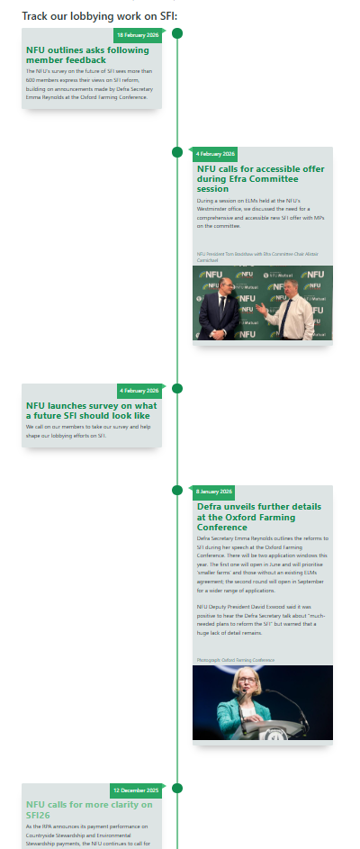
SFI - NFU Lobbying
Give greater transparency around the budget available for SFI – Expect more detail before the first window opens
Maximise the SFI budget
Retain a flexible range of actions for all sectors and locations – SFI26 still has a broad range of actions
If there needs to be budgetary controls, the NFU's preference is for a £/hectare limit – Not as severe as anticipated
Make the SFI farming-focused – Retained farming actions
Provide continuity for expiring legacy agreements – the problem is acknowledged
Notes:
‘Strikes the right balance’
The NFU worked to ensure there was an offer for all sectors.
More actions than anticipated – the upland offer has increased following our initial engagement
We did not get £/ha but our argument about delivering public goods will have contribute to the high agreement cap.
Legacy agreements remain a problem, Defra say they are working on a solution to allow applications to start before an agreement ends.

Slide 8
SFI in 2026 – Defra narrative
Simpler offer: 71 actions (down from 102); lower-uptake/impact actions removed
Fairer access: rate changes, stubble area cap, £100k annual agreement cap
Transparency: guidance and application window 1 budget published before it opens; spend updates during each window
Stability: SFI will remain consistent for this Parliament, with ongoing refinements and rate reviews

Slide 9
SFI26 changes
Agreement value cap: maximum £100,000 per year
Removed management payment
One SFI26 agreement per farm business also helps to manage value cap
Rotational actions: cannot exceed Year 1 area or value 5
Enhanced overwinter stubble (AHW7) counts towards the existing 25% farm area cap (across 10 actions)
All SFI26 actions will be 3-years in duration
Base and supplemental actions must be applied for together
Notes:
Agreement cap is per farm business i.e. SBI
Rotations - can move between fields and vary year to year, but not above Year 1
The 25% area cap applies across multiple SFI agreements. Agreements that started before 24 March 2024 do not have the 25% cap. If you have multiple agreements the total area of actions on this list needs to be included, including early SFI23 agreements.
To aide alignment of base and supplementary actions all will have the same agreement length – 3 years.

Slide 10
SFI 2026 Application Windows
Window 1
Window 2
Opens in June 2026 for ~2 months (or until budget is allocated)
Eligibility requires at least 3ha of land (at 1st January 2026)
Open to small farms (no less than 3ha up to 50 ha)
Open to farms without an RPA ELM revenue agreement
Opens in September 2026; closing date depends on demand
Eligibility requires at least 3ha of land (at 1st January 2026)
(ELM capital grants will open in July)
Notes:
The application windows will have a defined budget. Defra will notify how spend is going e.g. at 50% spend and then 75% spend
In window 1 it’s two groups that are eligible. It’s not small farmers without an ELM agreement
No ELM schemes means no SFI23, SFI24 CSMT, CSHT or HLS agreement.
3ha is an eligibility requirement across both application windows. This is based on holding size at 1 January 2026

Slide 11
SFI26 Payment Changes
Some payment rates updated in line with the ‘income foregone plus costs’ approach
Payment increases
Payment reductions
UPL1: Moderate livestock grazing on moorland £35/ha (increased from £20/ha)
UPL2: Low livestock grazing on moorland £89/ha (increased from £53/ha)
UPL3: Limited livestock grazing on moorland £111/ha (increased from £66/ha)
UPL8: Shepherding livestock on moorland (remove stock for at least 4 months) £74/ha (increased from £43/ha)
UPL10: Shepherding livestock on moorland (remove stock for at least 8 months) £102/ha (increased from £48/ha)
CSAM3: Herbal leys £224/ha (decreased from £382/ha)
CAHL2: Winter bird food £648/ha (decreased from £853/ha)
CNUM3: Legume fallow £532/ha (decreased from £593/ha)
Notes:
Payment increases – Defra has used ‘premium payments’ to increase the rates. This is paying a bonus for actions they want to see.
Payment decreases – IF+C has been used. Defra has used a different point in the cost curve for calculating the payments.

Slide 12
SFI actions NOT in 2026 offer (1)
Soils
CSAM1 Soil management plan
SOH2 Spring-sown cover crop
SOH4 Winter cover following maize
IPM
CIPM1 IPM plan
Nutrients
CNUM1 nutrient management plan
Precision farming
PRF3 Non-mechanical robotic weeding
Boundaries
CHRW1 Assess and record hedgerow condition
CHRW3 Maintain or establish hedgerow trees
Notes:
NFU lobbying secured stone walls and earthbanks
Soil – plan =no environmental delivery which is low value. For Spring cover crop alternate actions deliver similar outcomes
IPM & Nutrients – plans don’t deliver environmental outcomes
PRF3 – very low uptake due to lack of contractors with equipment
Hedges – paying for trees is low value for money. Farmers retain them.

Slide 13
SFI actions NOT in 2026 offer (2)
Arable wildlife
AHW1 Bumblebird mix
AHW12 woodland edges on arable land
Grassland wildlife
GRH6 species-rich grassland
GRH11 Cattle grazing supplement (non-moorland)
Buffers
BFS2/BFS3 Buffer in-field ponds
BFS4/ BFS5 Protect in-field trees
Species Recovery
SPM2 Native breeds on grazed habitats supplement (50-80%)
SPM4 Native breeds on extensively managed habitats supplement (50-80%)
Notes:
NFU lobbying secured:
some native breeds at risk actions
Supplementary winter bird food
Enhanced overwintered stubble
and BFS6 6-12m habitat strip next to watercourses.
Arable – low uptake actions. Remaining actions deliver similar aims e.g. pollen & Nectar mix, winter bird food, field corners
Grassland – species rich; endorsed action being removed as part of simplification. GRH11 is a supplement more suited to CSHT.
Buffers – low uptake and alternatives available.
Native breeds – don’t contribute to water or biodiversity targets

Slide 14
SFI actions NOT in 2026 offer (3)
Moorland
CMOR1 Assess moorland
UPL4 Keep cattle and ponies on moorland supplement (<30% GLU)
UPL7 Shepherding livestock on moorland (no required stock removal period)
UPL9 Shepherding livestock on moorland (remove stock for at least 6 months)
Waterbodies
WBD5 Intensive grassland adjacent to a watercourse
WBD8 Manage grassland to reduce nutrient levels in groundwater
WBD9 Nil fertiliser supplement
Notes:
NFU lobbying secured a wider offer for moorlands e.g. retention of UPL1, keeping a cattle and pony supplement, & native breeds at risk
Moorlands – low uptake actions with alternatives available. Plans don’t deliver environmental benefits.
Waterbodies – low uptake actions being removed to deliver simplification

Slide 15
For more information:
NFU ONLINE: www.nfuonline.com
NFU Call First: 0370 845 8458
9:30am on Wednesday for NFU Webinar on FETF. REGISTER AT NFU ONLINE
Defra: www.gov.uk/environment/food-and-farming
Notes:
NFU lobbying secured a wider offer for moorlands e.g. retention of UPL1, keeping a cattle and pony supplement, & native breeds at risk
Moorlands – low uptake actions with alternatives available. Plans don’t deliver environmental benefits.
Waterbodies – low uptake actions being removed to deliver simplification

